Slide 1
Diversification Analyses EEBL 606 21 Feb 2018 Heath Blackmon

Slide 2
Previously
Dr. Conway: Why are we interested in phylogenies and what are the philosophical and logical premises that we base our work on.
Dr. Song: How do we go about making trees in the real world. What programs do we use what challenges do we face.

Slide 3
Systematics in 21st C?
Taxonomy
Nomenclature
Evolutionary Relationships
Classification
Character evolution

Slide 4
Today: Applied phylogenetics
Applied Phylogenetics
Character evolution
Morphology
Genes/Networks
Diversification analysis
Biogeographic analysis

Slide 5
Today: Applied phylogenetics
Applied Phylogenetics
Character evolution
Morphology
Genes/Networks
Diversification analysis
Biogeographic analysis

Slide 6
Common Questions
Is group A diversifying more quickly than group B?
Is state 1 of a trait associated with faster diversification than state 2?
Is clade A an example of an adaptive radiation?

Slide 7
Terminology
Diversification:
Disparification:
Adaptive Radiation:

Slide 8
Terminology
Diversification: increase in the number of lineages through time
Disparification
Adaptive Radiation:

Slide 9
Terminology
Diversification: increase in the number of lineages through time
Disparification: increase in the range of trait values in a clade through time
Adaptive Radiation:

Slide 10
Terminology
Diversification: increase in the number of lineages through time
Disparification: increase in the range of trait values in a clade through time
Adaptive Radiation: diversification facilitated by new adaptive traits

Slide 11
Terminology
Diversification: increase in the number of lineages through time - richness
Disparification: increase in the range of trait values in a clade through time - variance
Adaptive Radiation: diversification facilitated by new adaptive traits

Slide 12
Methods
Sister clade contrasts
Explicit model based approaches (BiSSE, BAMM, etc.)
The controversy over BiSSE/BAMM
LTT

Slide 13
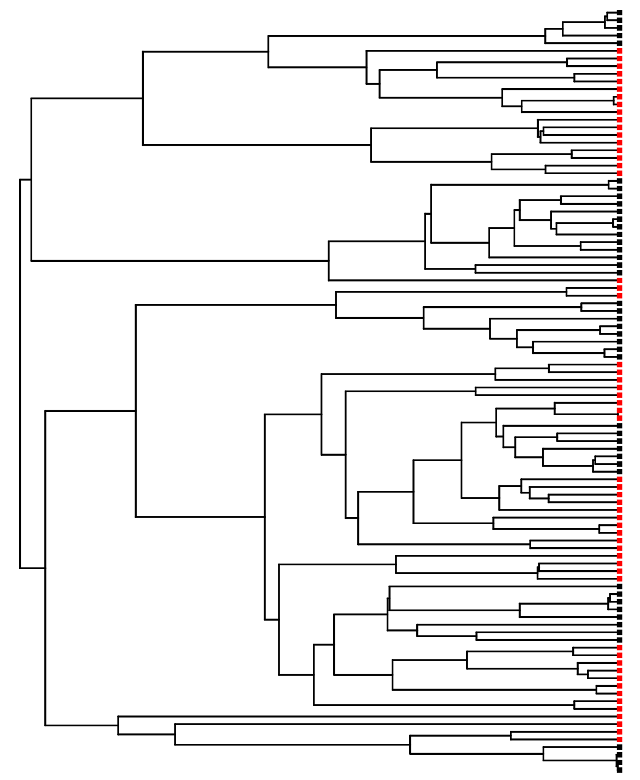
Sister clade contrasts

Slide 14
Sister clade contrasts

Slide 15
Sister clade contrasts
1
2
3
4
5
1
2
3
4
5
6
7
8
9

Slide 16
Sister clade contrasts

Slide 17
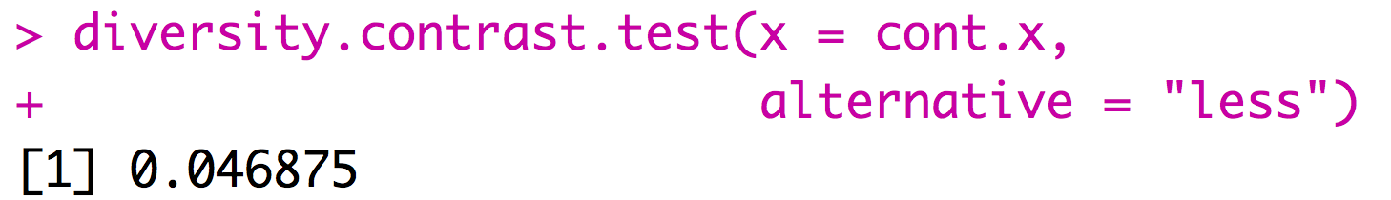
Sister clade contrasts
1
node | Red species | Black species
117 | 9 | 5
238 | 1 | 13
164 | 2 | 8
271 | 3 | 7
105 | 7 | 8
129 | 2 | 4
= cont.x
2
3
4
5
General rule need around 5 comparisons to get P < 0.05
Use R package APE or beware that some old methods still implemented
6

Slide 18
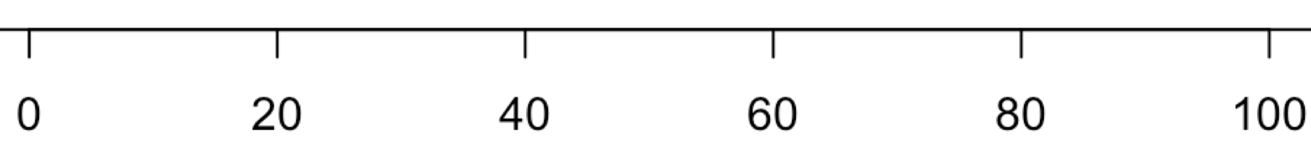
Problems with sister clade contrasts
time
Notes:
Draw it on the board

Slide 19
Problems with sister clade contrasts
Notes:
Draw it on the board

Slide 20
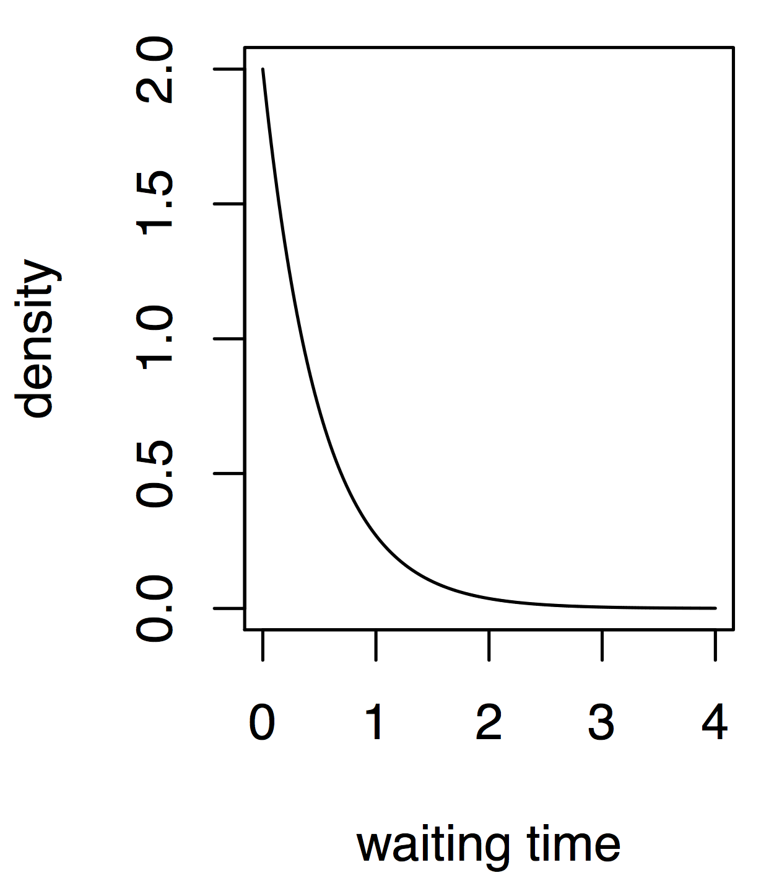
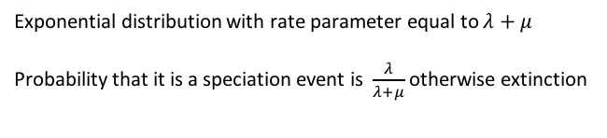
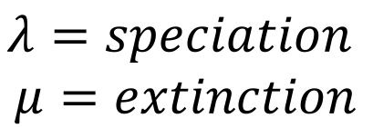
Explicit model based approach
$$λ=speciation$$
$$μ=extinction$$
Exponential distribution with rate parameter equal to $λ+μ$
Probability that it is a speciation event is $\frac{λ}{λ+μ}$ otherwise extinction

Slide 21
Explicit model based approach
$$λ=speciation$$
$$μ=extinction$$
Present
0.96
Exponential distribution with rate parameter equal to $λ+μ$
Probability that it is a speciation event is $\frac{λ}{λ+μ}$ otherwise extinction
4 3 2 1
Time before present

Slide 22
Explicit model based approach
$$λ=speciation$$
$$μ=extinction$$
Present
0.96
Exponential distribution with rate parameter equal to $λ+μ$
Probability that it is a speciation event is $\frac{λ}{λ+μ}$ otherwise extinction
4 3 2 1
Time before present

Slide 23
Explicit model based approach
$$λ=speciation$$
$$μ=extinction$$
Present
Exponential distribution with rate parameter equal to $λ+μ$
Probability that it is a speciation event is $\frac{λ}{λ+μ}$ otherwise extinction
4 3 2 1
Time before present

Slide 24
Explicit model based approach
$$λ=speciation$$
$$μ=extinction$$
Present
Exponential distribution with rate parameter equal to $λ+μ$
Probability that it is a speciation event is $\frac{λ}{λ+μ}$ otherwise extinction
4 3 2 1
Time before present

Slide 25
Explicit model based approach
$$λ=speciation$$
$$μ=extinction$$
Present
Exponential distribution with rate parameter equal to $λ+μ$
Probability that it is a speciation event is $\frac{λ}{λ+μ}$ otherwise extinction
4 3 2 1
Time before present

Slide 26
Explicit model based approach
$$λ=speciation$$
$$μ=extinction$$
Present
Exponential distribution with rate parameter equal to $λ+μ$
Probability that it is a speciation event is $\frac{λ}{λ+μ}$ otherwise extinction
4 3 2 1
Time before present

Slide 27
Explicit model based approach
$$λ=speciation$$
$$μ=extinction$$
Present
Exponential distribution with rate parameter equal to $λ+μ$
Probability that it is a speciation event is $\frac{λ}{λ+μ}$ otherwise extinction
4 3 2 1
Time before present

Slide 28
Explicit model based approach
$$λ=speciation$$
$$μ=extinction$$
Present
Exponential distribution with rate parameter equal to $λ+μ$
Probability that it is a speciation event is $\frac{λ}{λ+μ}$ otherwise extinction
4 3 2 1
Time before present

Slide 29
Explicit model based approach
$$λ=speciation$$
$$μ=extinction$$
Present
Exponential distribution with rate parameter equal to $λ+μ$
Probability that it is a speciation event is $\frac{λ}{λ+μ}$ otherwise extinction
4 3 2 1
Time before present

Slide 30
Explicit model based approach
$$λ=speciation$$
$$μ=extinction$$
Present
Exponential distribution with rate parameter equal to $λ+μ$
Probability that it is a speciation event is $\frac{λ}{λ+μ}$ otherwise extinction
4 3 2 1
Time before present
Notes:
Show it in R

Slide 31
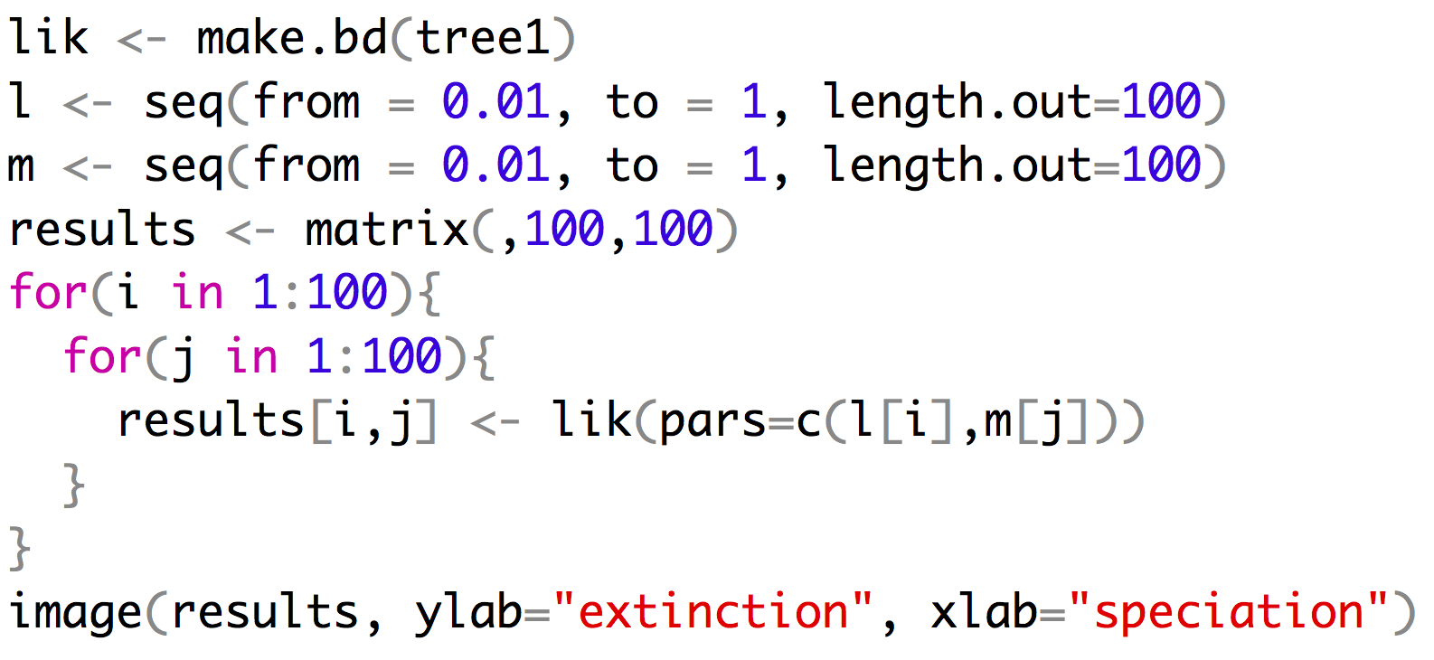
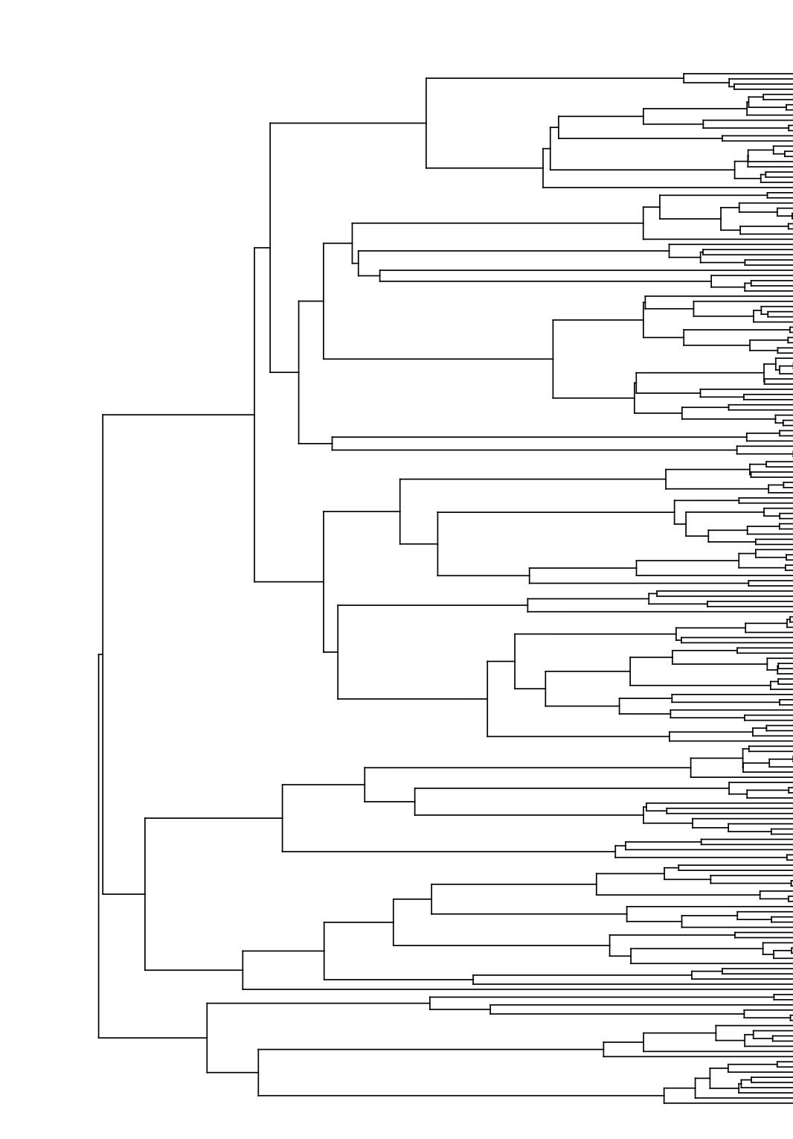
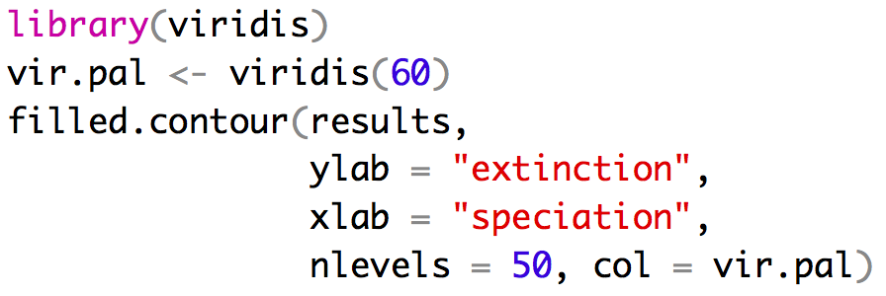
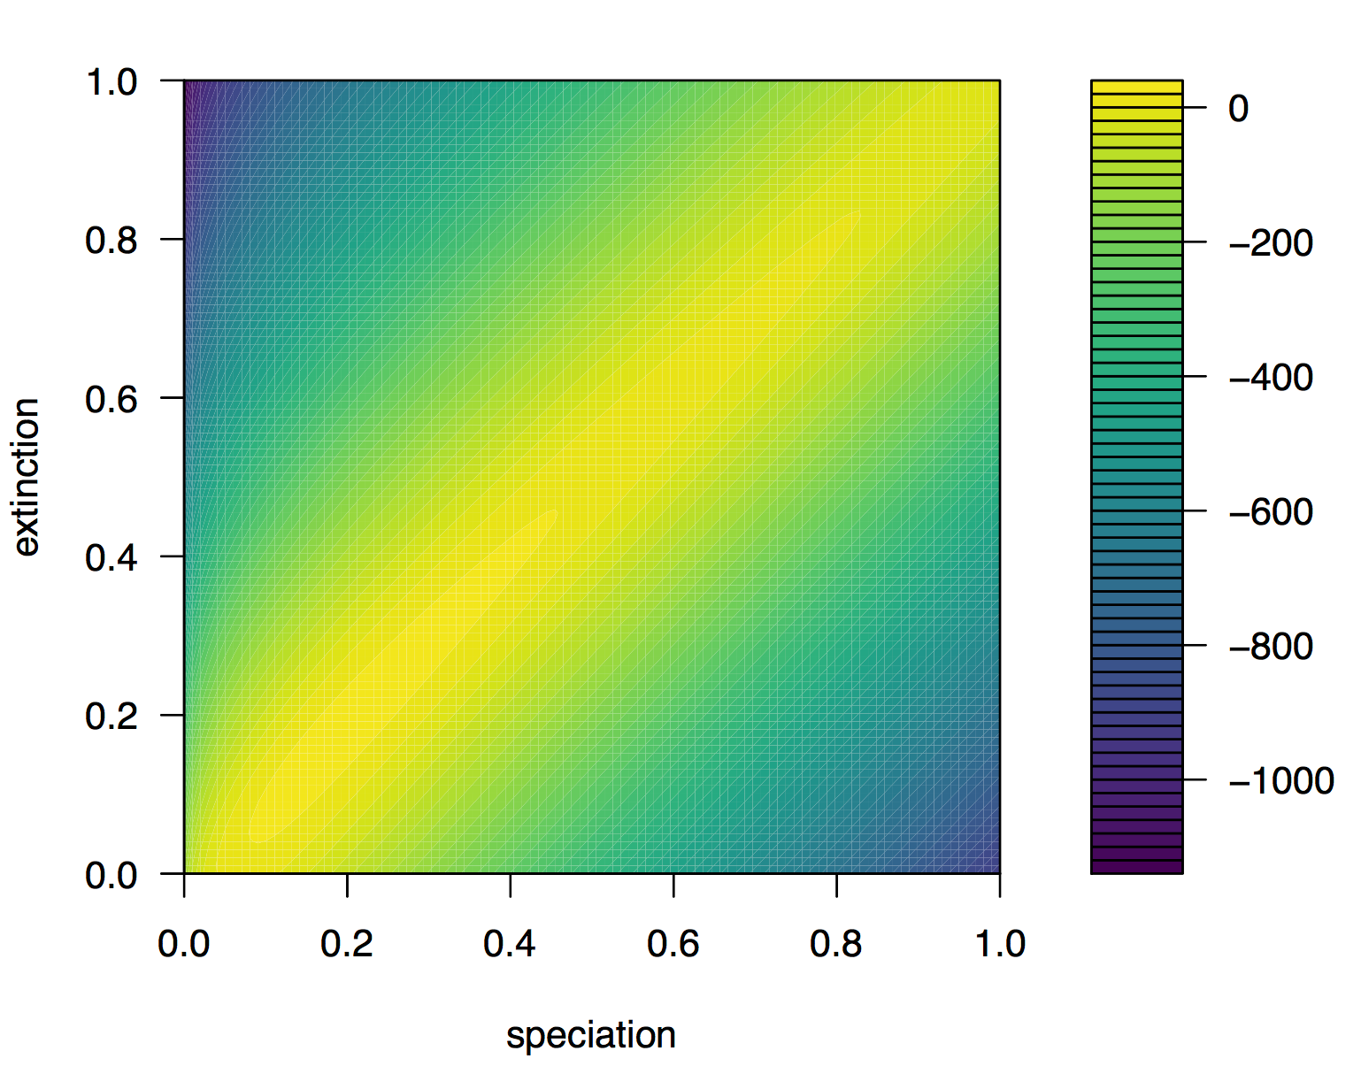
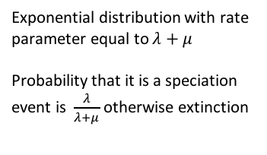
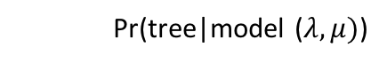
Explicit model based approach
$$λ=speciation$$
$$μ=extinction$$
Pr(tree|model ($λ,μ)$)
Exponential distribution with rate
parameter equal to $λ+μ$
Probability that it is a speciation
event is $\frac{λ}{λ+μ}$ otherwise extinction
True value

Slide 32
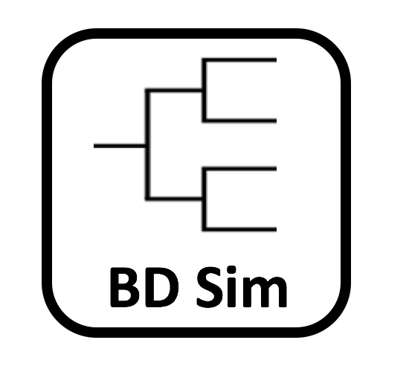
High Variance in species under the BD model

Slide 33
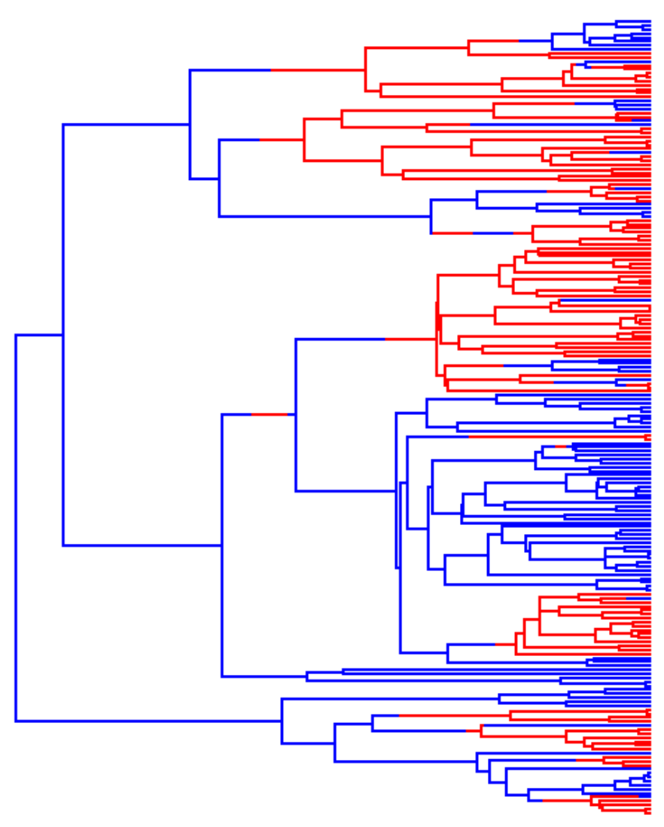
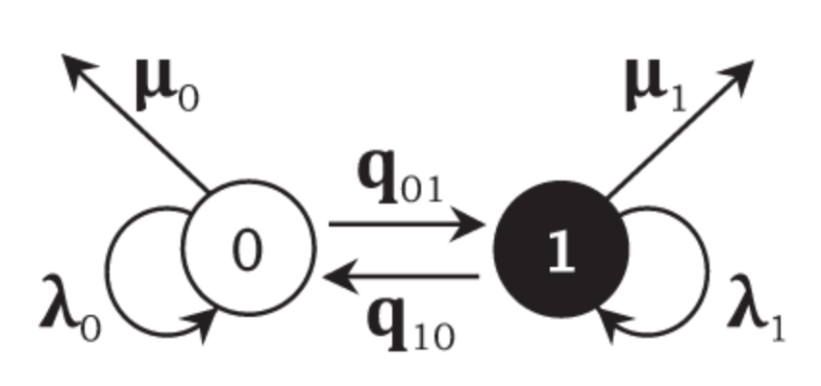
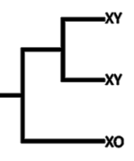

BiSSE
SSE = state dependent
speciation and extinction
This method has gone on to spur the development of many extensions
BiSSE
MuSSE
QuaSSE
GeoSSE
HiSSE
ChromeTrait

Slide 34
BiSSE
Despite the desire people have to use BiSSE(and extensions) it has some problems.
- pseudoreplication
- many/most empirical trees contain the signature of rate variation
Rabosky and Goldberg 2015

Slide 35
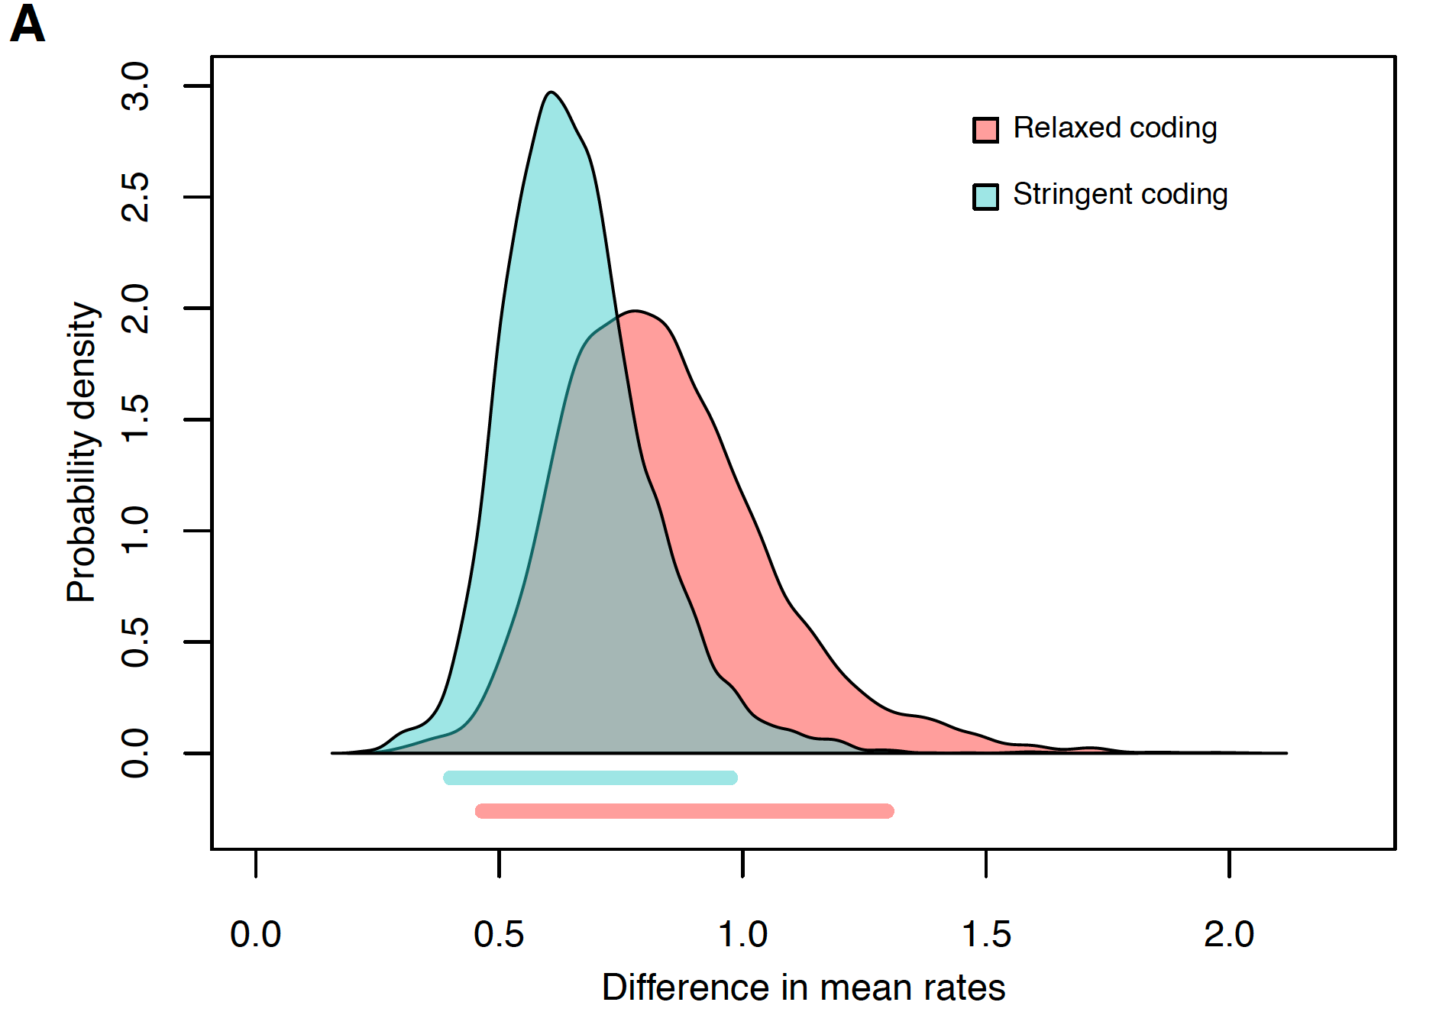
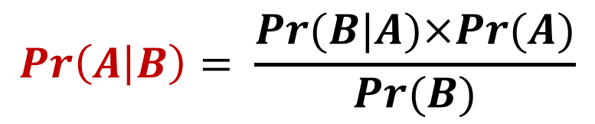
Bayesian refresher
$$\operatorname{Pr}\left(A | B\right)= \frac{Pr⁡(B|A)×Pr⁡(A)}{Pr⁡(B)}$$
Notes:
finish

Slide 36
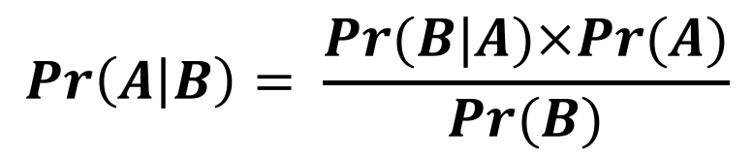
Bayesian refresher
Pr(B|A) this is just the likelihood of our data given our model and current parameters
Pr(A) is the prior this is a distribution that described the probabilities of different values of A
$$\operatorname{Pr}\left(A | B\right)= \frac{Pr⁡(B|A)×Pr⁡(A)}{Pr⁡(B)}$$
A is the thing we are interested in (phylogeny, age of a node, number of rate shifts, extinction rate)
Pr(B) this is just the likelihood of our data we don’t actually deal with this unless you are developing the software
Notes:
finish

Slide 37
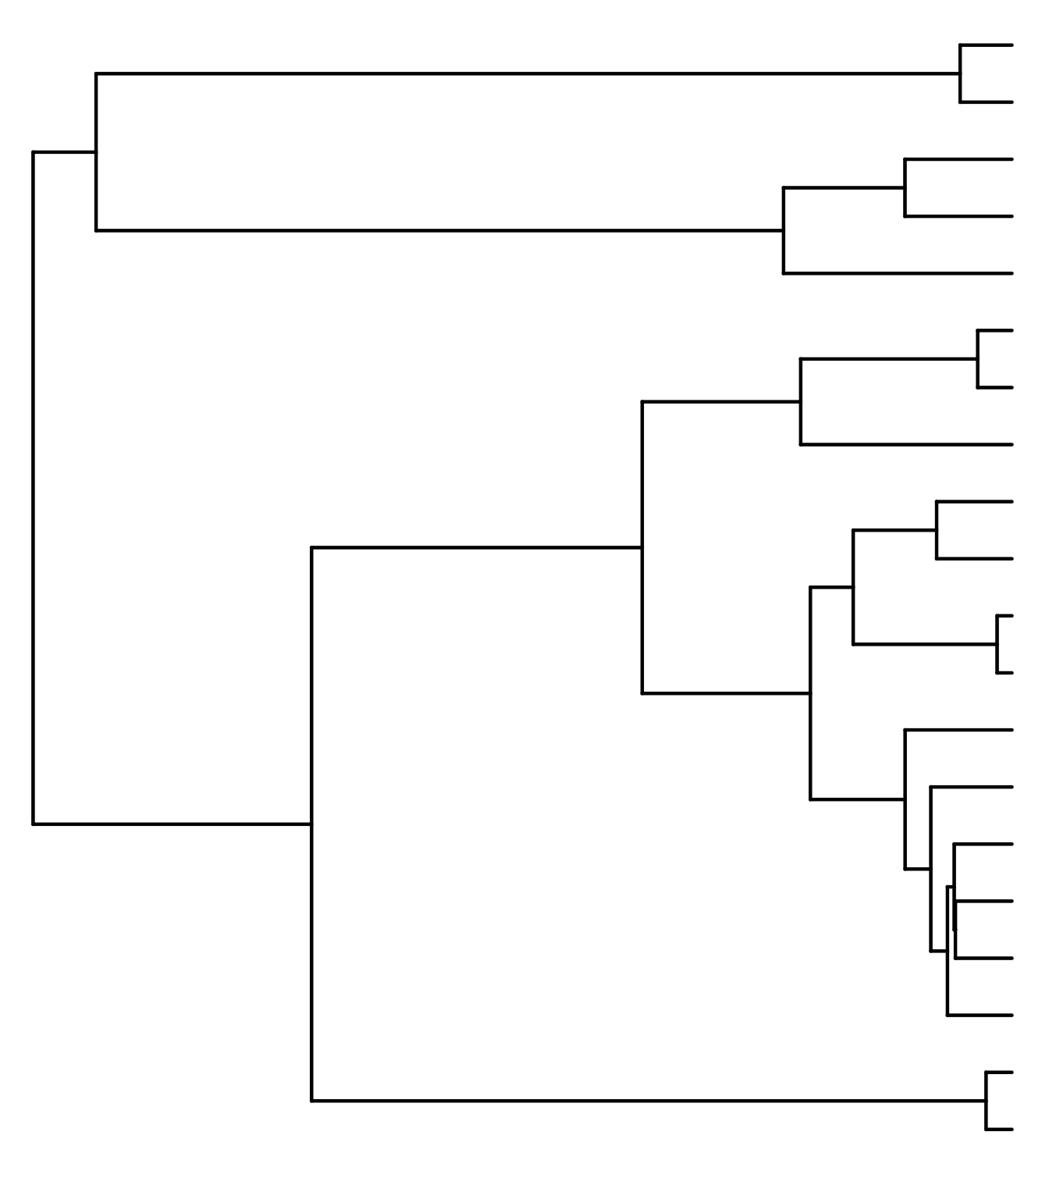
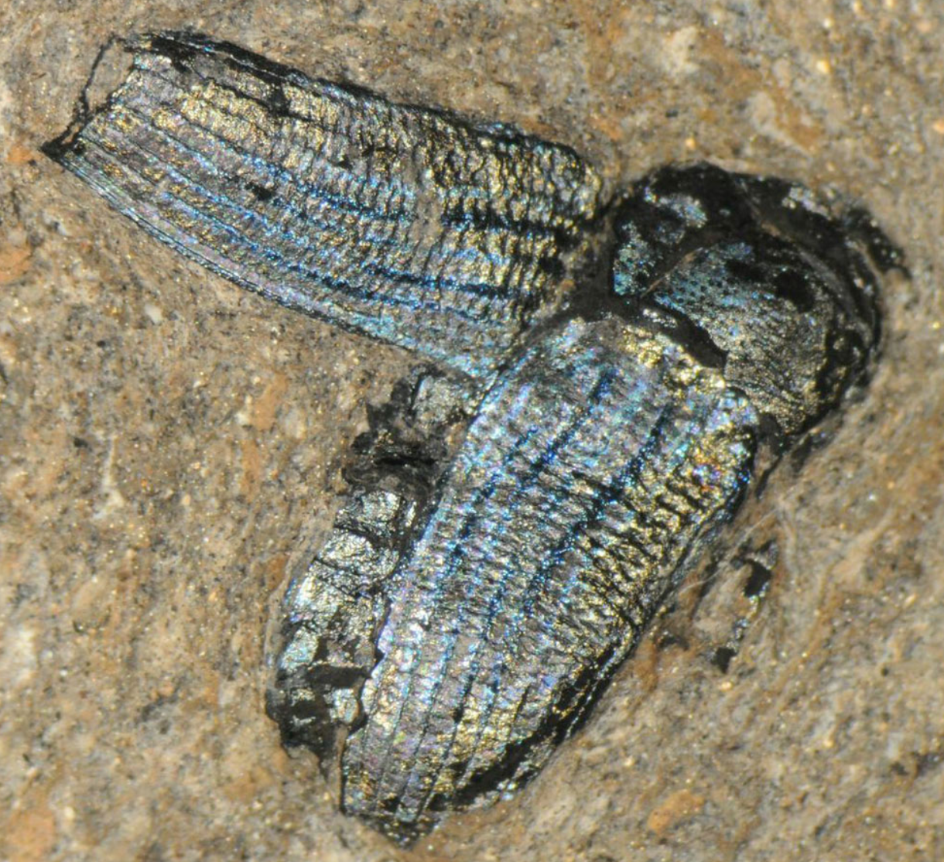
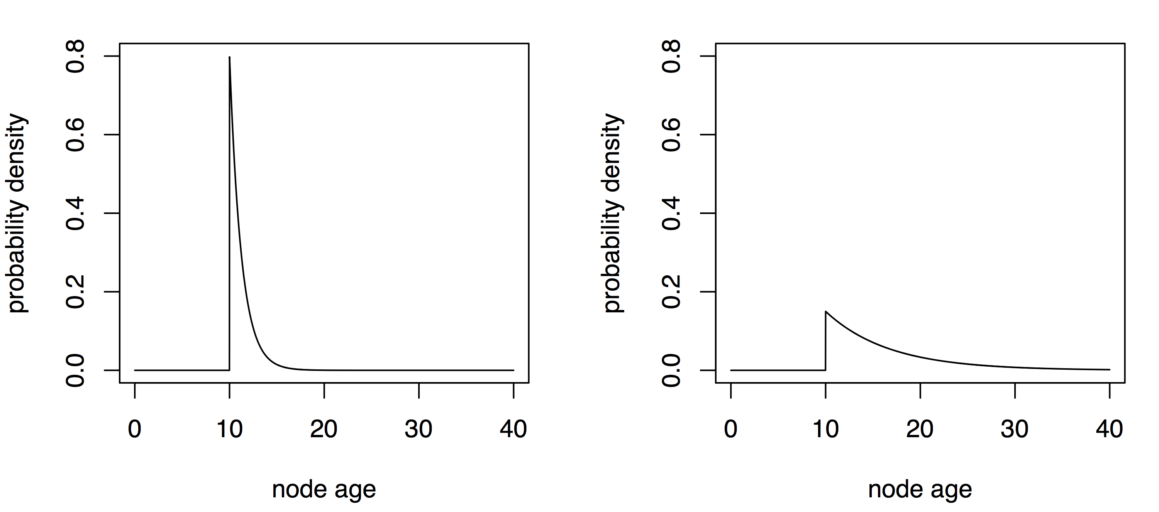
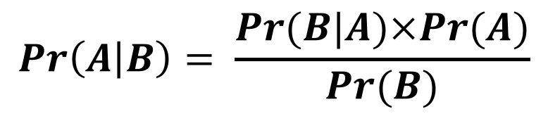
Bayesian refresher – age of a node
$$\operatorname{Pr}\left(A | B\right)= \frac{Pr⁡(B|A)×Pr⁡(A)}{Pr⁡(B)}$$
Age estimate
10 MYA
Two possible priors
Prior might drive the result if the data are not very informative
Notes:
finish

Slide 38
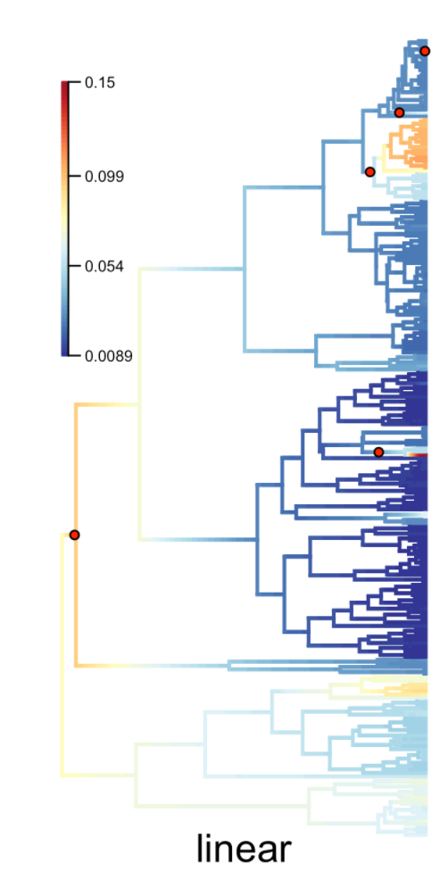

BAMM
BAMM (Bayesian analysis of macroevolutionary mixtures)
Infers
Number of shifts among diversification regimes
Characteristics of each regime
The idea is powerful you can give it a phylogeny it will find the interesting points where the mode of evolution has changed.
Became popular almost immediately.
351 citations for the 2014 paper that includes initial description.
Dan Rabosky

Slide 39

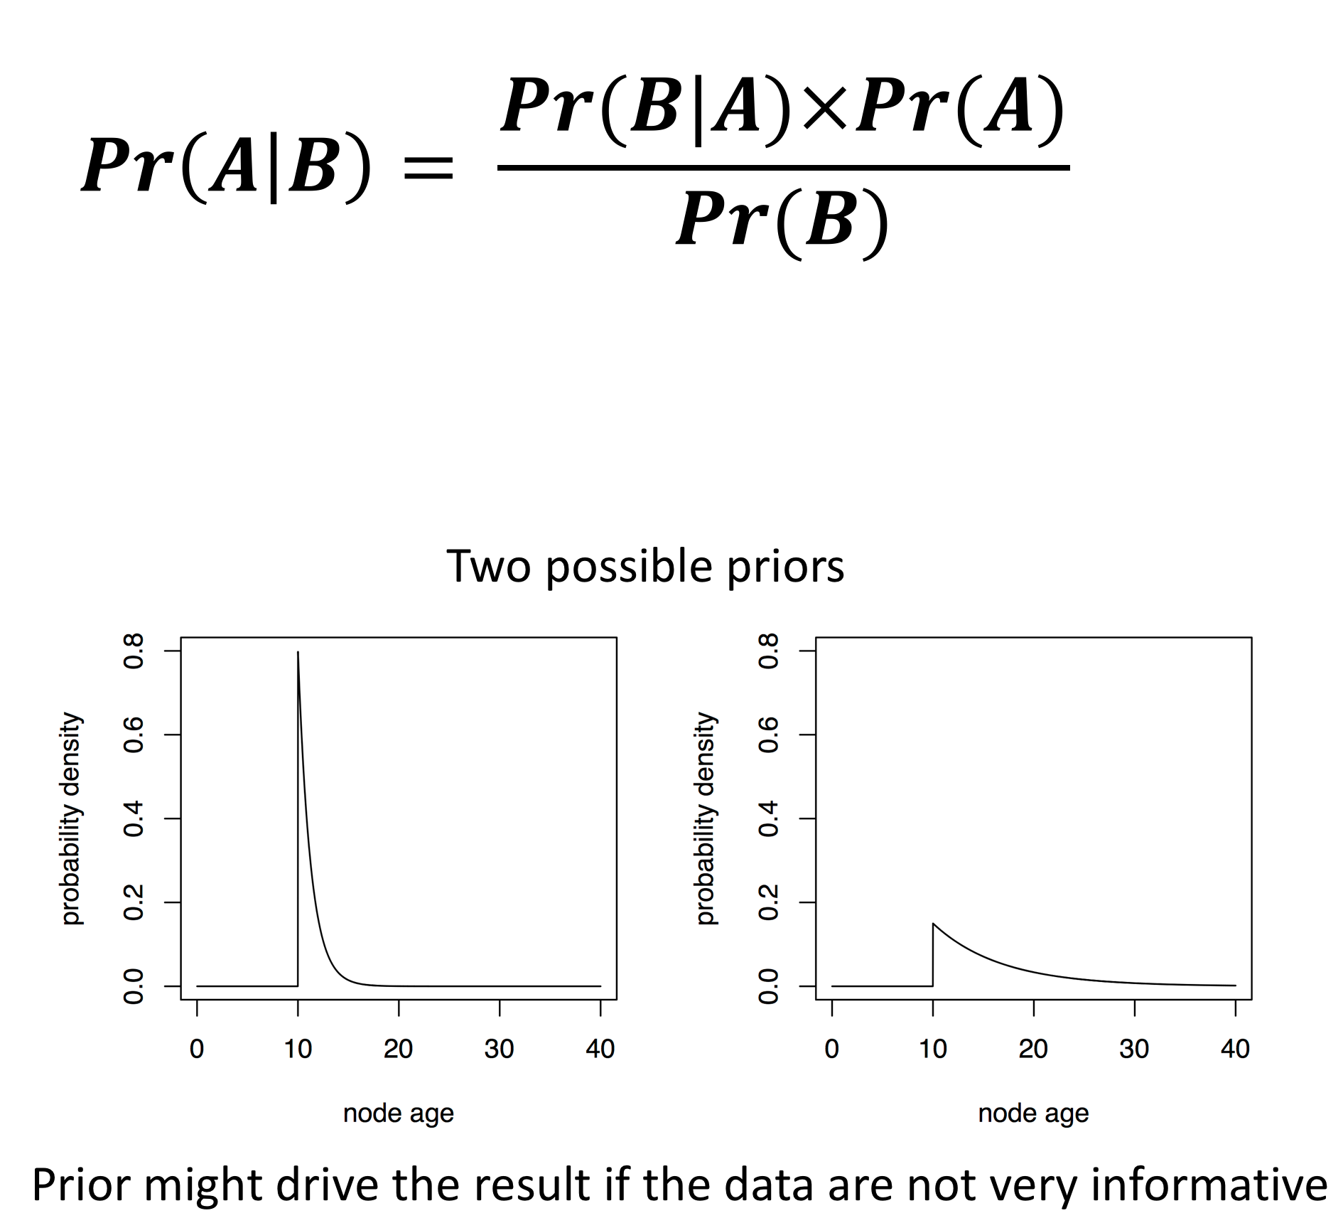
BAMM controversy
The compound Poisson process distribution that describes how we expect rate shifts to be observed is statically hard to identify making analyses very sensitive to the prior specification.
A problem with how we account for rate shifts in unobserved lineages leads to a bias in the estimates of extinction probabilities. Making the likelihoods calculated incorrect – suggest a computationally costly solution.
Take together these lead to unreliable hypothesis testing – based on simulation study.
molecular ecologist blog
treethinkers blog
Brian Moore
Can’t replicate with version 2.5 or later.
Disagree about the problem – and claim mathematical error in possible solution.
Can’t replicate problems even when making simulations more difficult
Dan Rabosky

Slide 40
My Advice
If you are interested in diversification.
Use more than one method
Play with priors and compare your results with very different priors
If you use BAMM and find the same rate shifts regardless of the prior that you use some reviewers will accept your results.
If you can also show that these results are consistent with other approaches to analyzing your data more reviewers will accept your results.

Slide 41
My Advice
If you are interested in diversification.
Use more than one method
Play with priors and compare your results with very different priors
If you use BiSSE and find a significant difference in
diversification between your two character states.
(our reading discusses why reviewers might not trust this)
Consider running BiSSE on subclades within your
phylogeny that differ in the trait of interest.
1
2
3
4
5
6

Slide 42
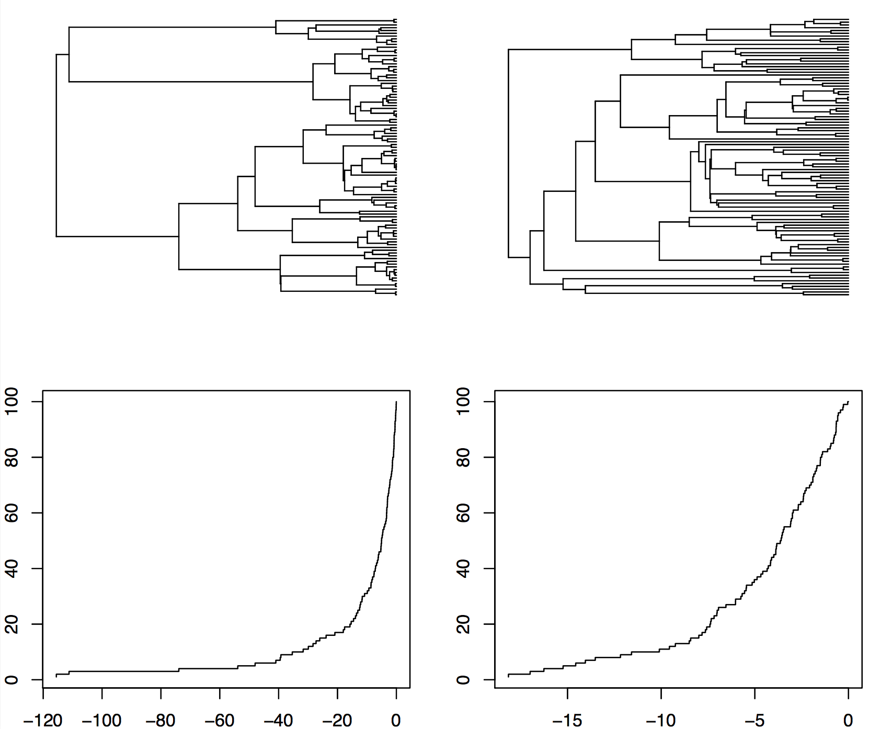
LTT Plots
If we assume a birth death model the large uptick in an LTT plot as we reach the present day is caused by sampling lineages that are likely to go extinct in the future.
Pull of the present

Slide 43
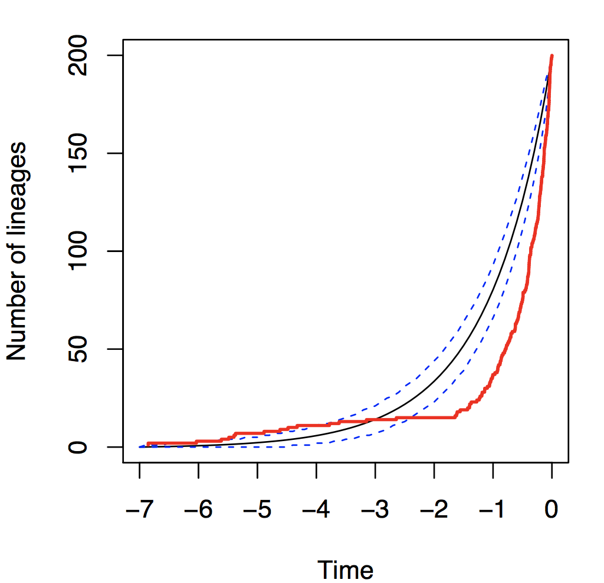
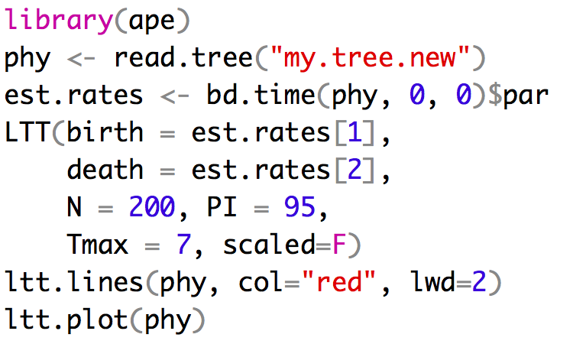
LTT Plots are put to many uses

Slide 44
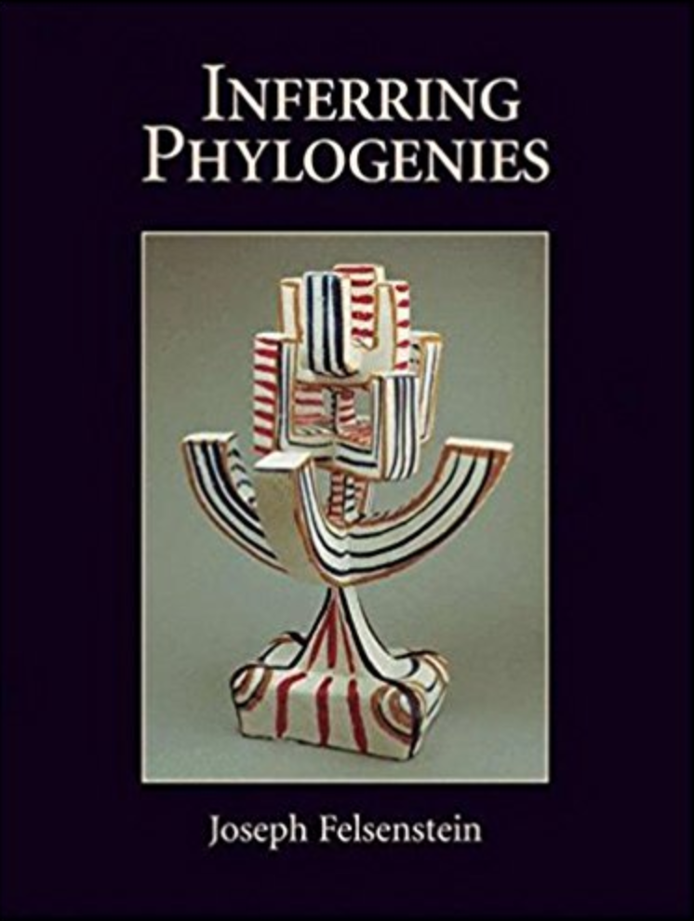
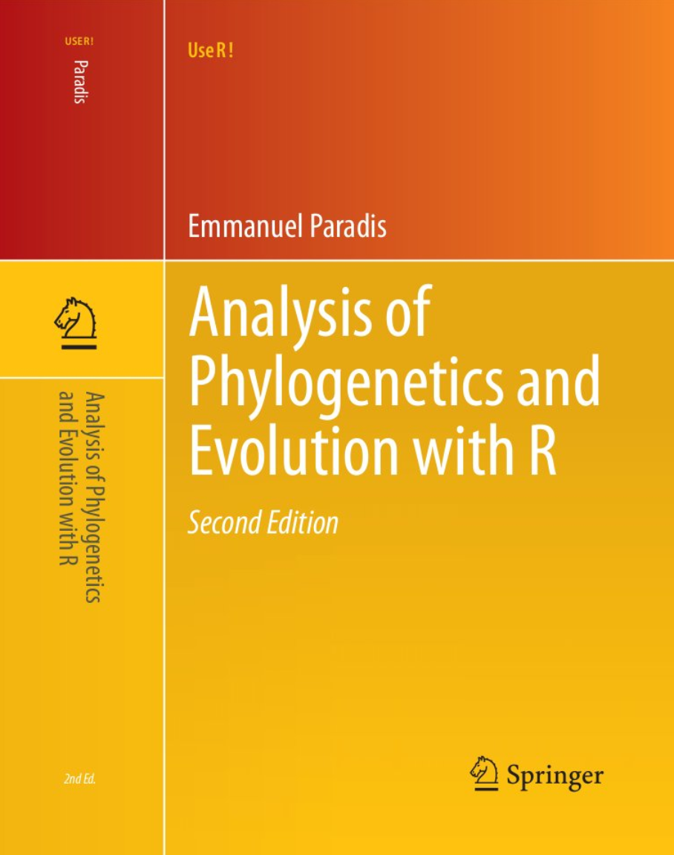
Take homes
Differential diversification analyses are hard!
Easy to get a false positive
Easy to use the wrong approach
You can still do differential diversification
My door is always open
CRAN Taskview
Workshops
Bodega – Bayesian/cheap
MBL – More molecular/very expensive
Nimbios – RevBays

